Slide 1
Text Summariser
CSN-300 Lab Based Project
Priyanshu Nareda
Sarvesh Baheti

Slide 2

Introduction and Progress
Final Project
Backend
Frontend
Extraction Based Model
Abstraction Based Model
Frontend Website Design
Fine-tuning Model
Integration of Models

Slide 3
Architecture : Extraction Based Summariser
Input Layer Module
X
1
Tokenization
Stopword Removal
Preprocessing module
2
Cleaning
TF-IDF Vectorization
Summary Generation Module
3
Cosine Similarities
Sentence Ranking Module

Slide 4
Architecture : Abstraction Based (phi-3)
Input Layer
X
1
Preprocessing Layer
2
Input Processing
Embedding Layer
Model Integration
Layer
3
Transformer Encoder-Decoder Model
Contextual Reinforcement
Output Layer
Output Post-processing
4

Slide 5
Architecture : Abstraction Based (T5)
Input Layer
X
1
Tokenization
Cleaning
Preprocessing Layer
2
Encoder (Bidirectional Attention)
Model Integration
Layer
3
Decoder (Auto-regressive Generation)
Text Generation & Decoding Strategies
Output Layer
Output Post-processing
4

Slide 6
Datasets
We have obtained two datasets from Kaggle to fine tune the abstractive-based summariser and test both the models::
CNN News Articles
unique news articles and their summaries as written by journalists at CNN and the Daily Mail
supports both extractive and abstractive summarisation
BBC News Summary
articles and their summariser classified into five categories - business, entertainment, politics, sport and tech
supports extractive summarisation only

Slide 7
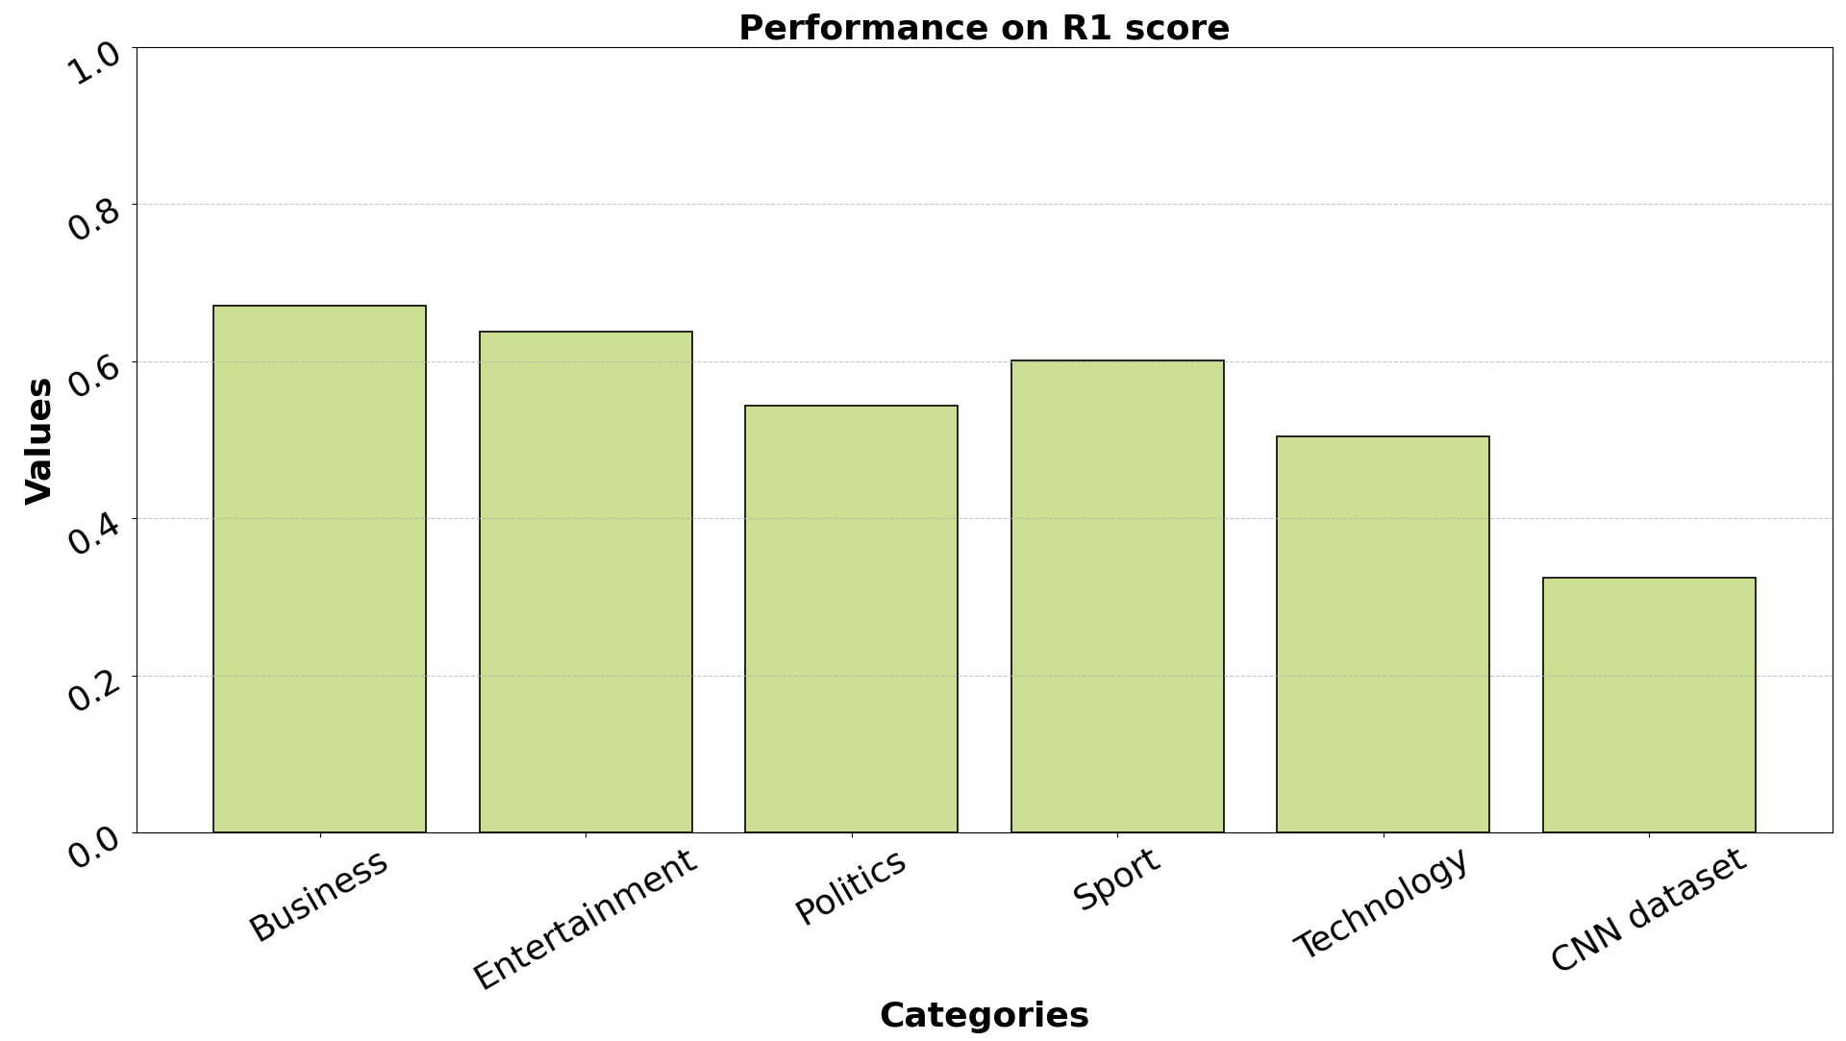
Results: Extractive Summariser
R1 score: Overlap of unigrams between generated and reference summary

Slide 8
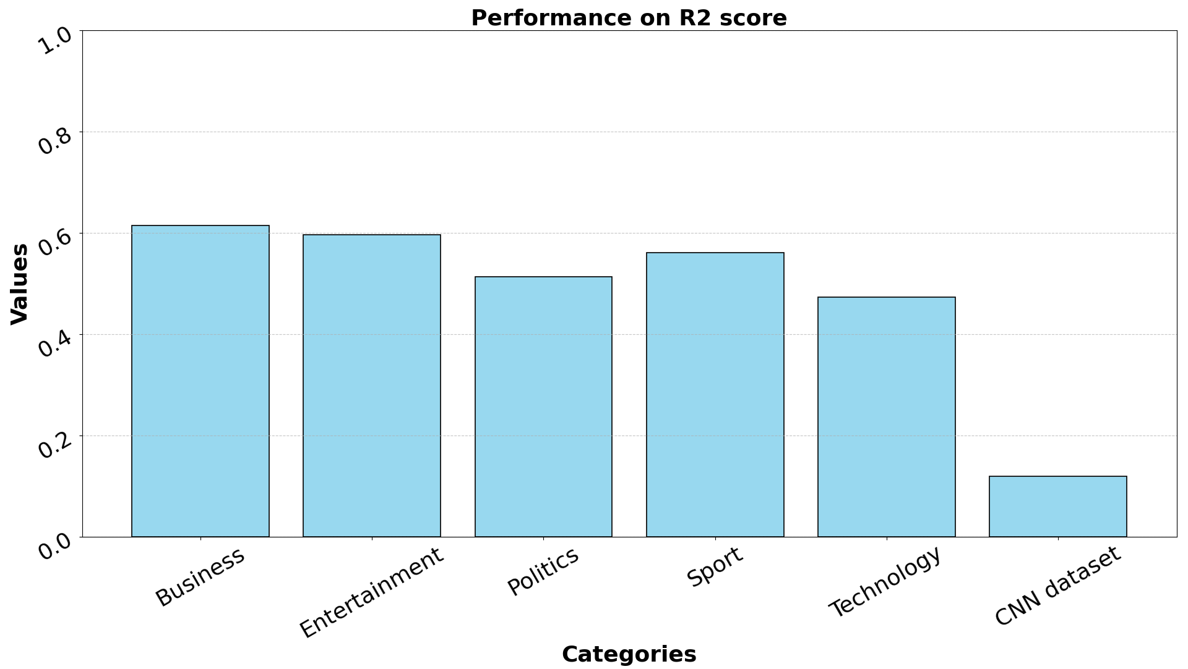
Results: Extractive Summariser
R2 score: Overlap of bigrams between generated and reference summary

Slide 9
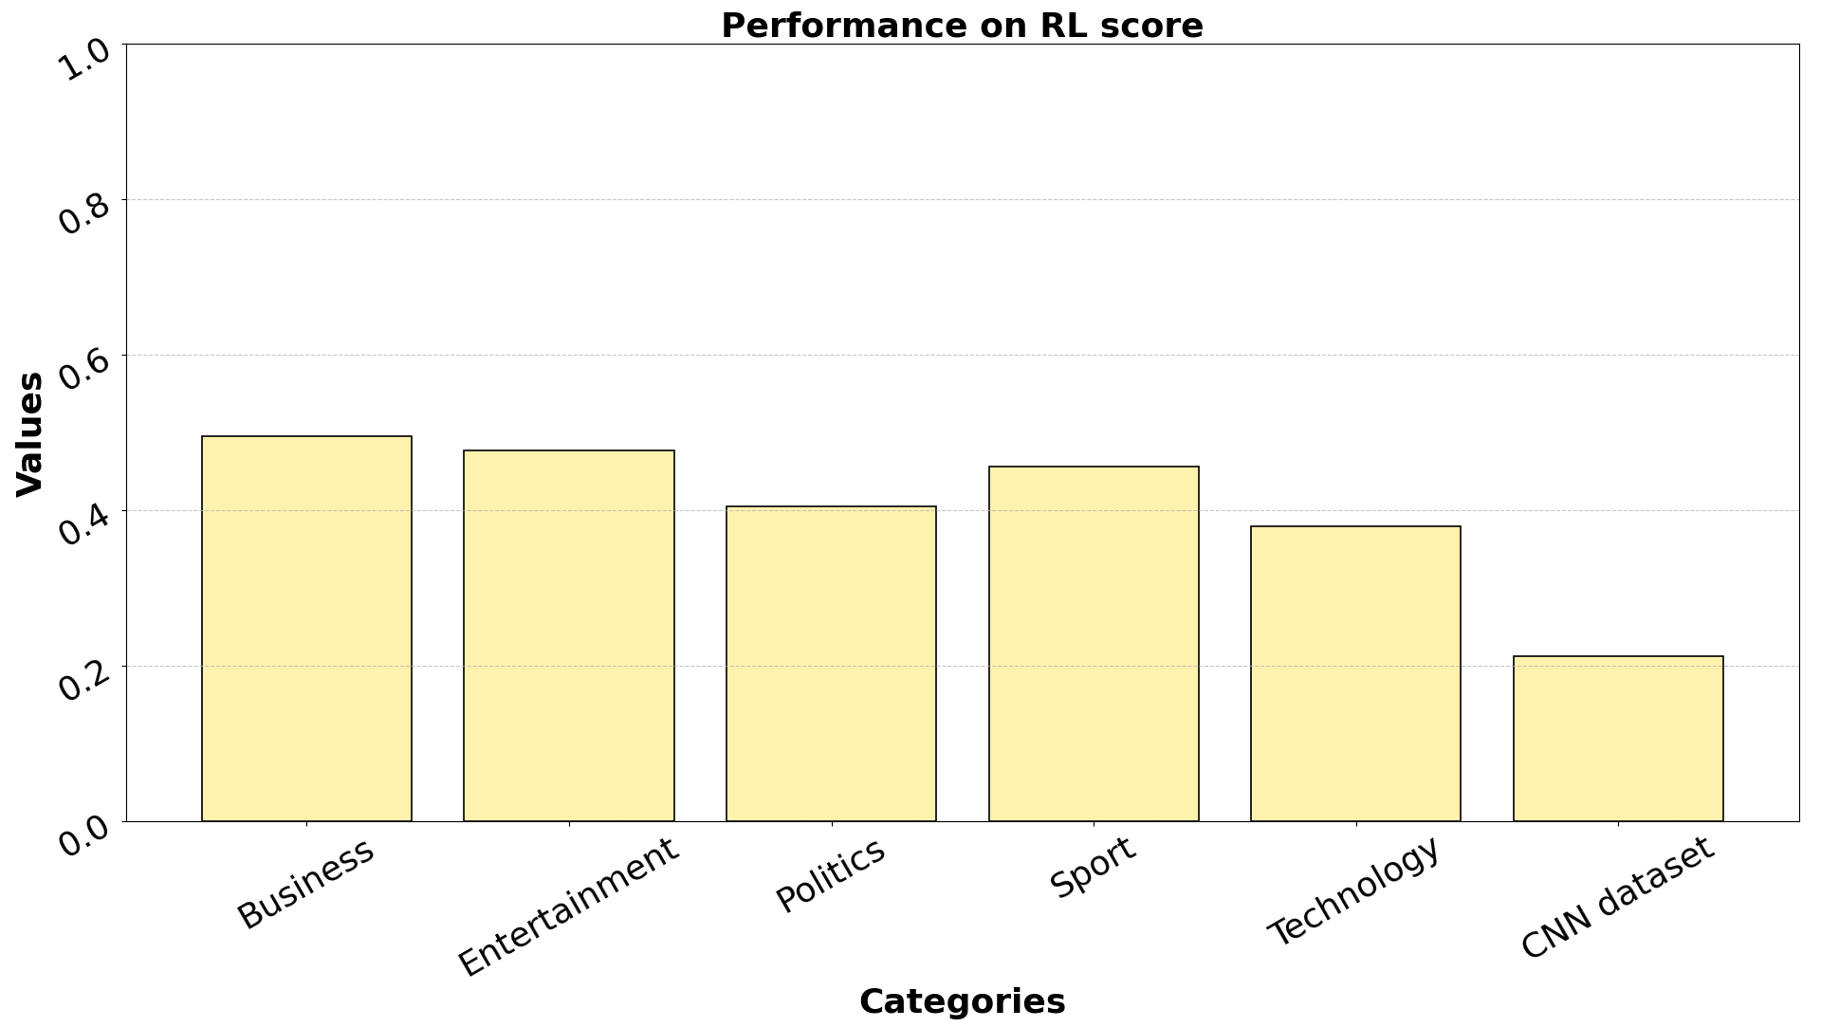
Results: Extractive Summariser
RL score: Measure LCS between generated and reference summary

Slide 10
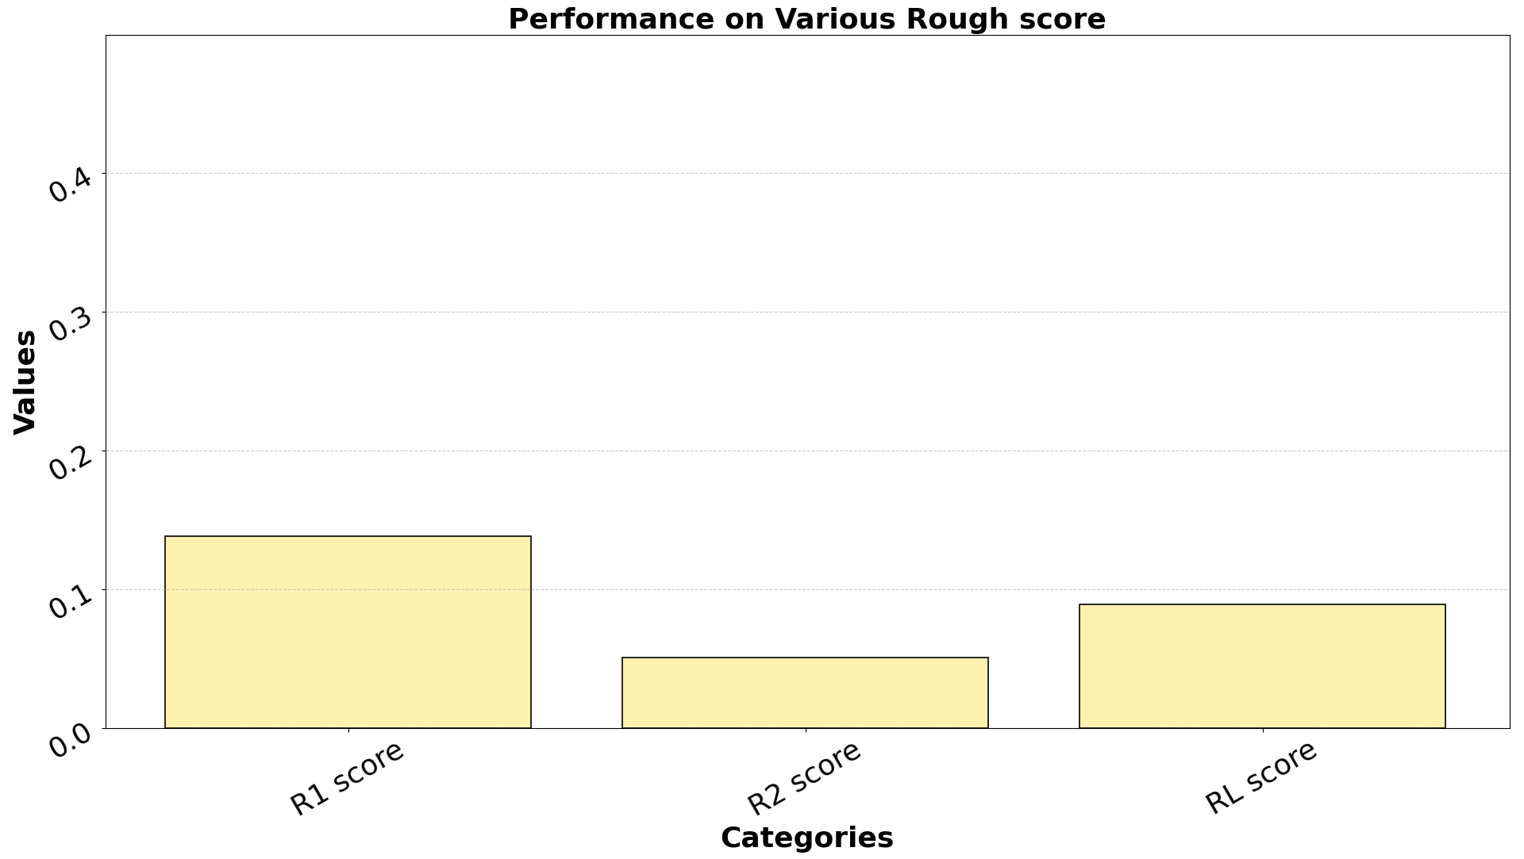
Results: Abstractive Summariser
R1, R2 and RL score of phi-3 model

Slide 11
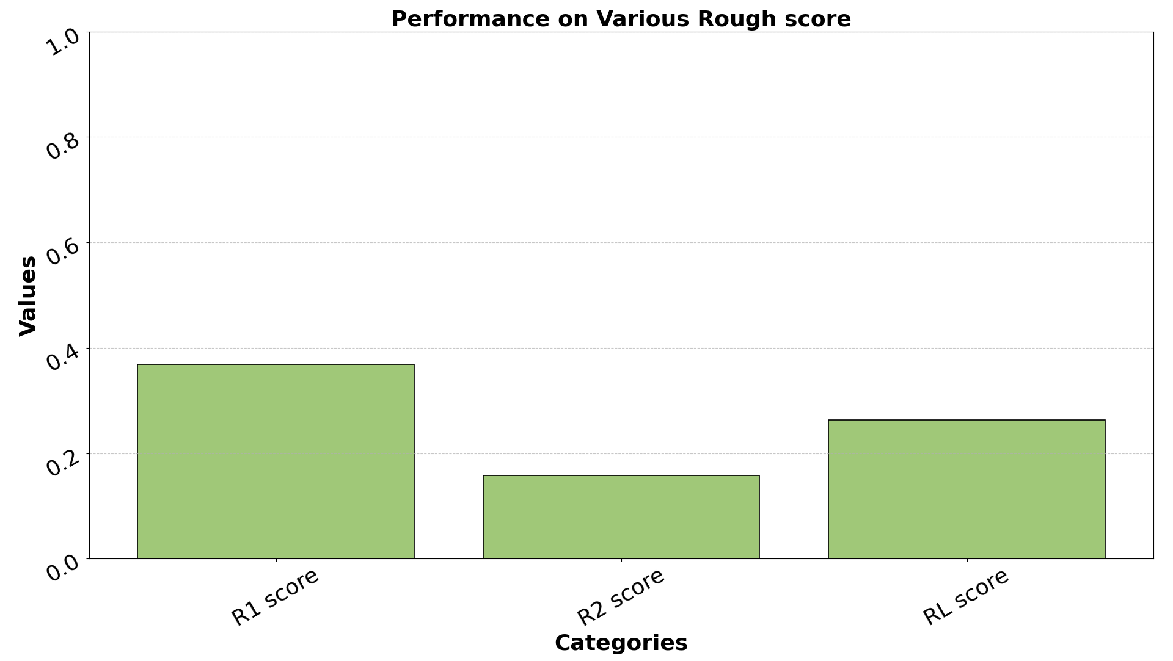
Results: Abstractive Summariser
R1, R2 and RL score of T5 model

Slide 12
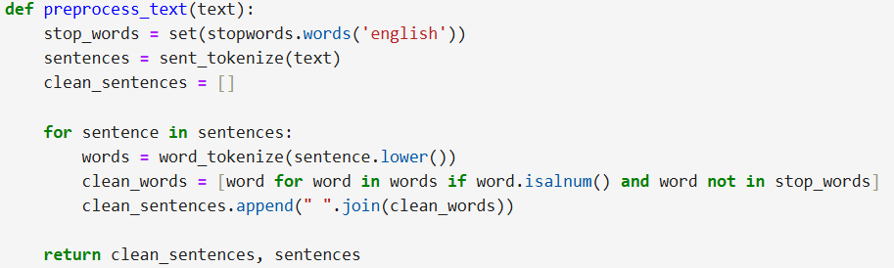
Code
This function tokenizes text into sentences, removes stopwords and non-alphanumeric words, and returns cleaned and original sentences.

Slide 13
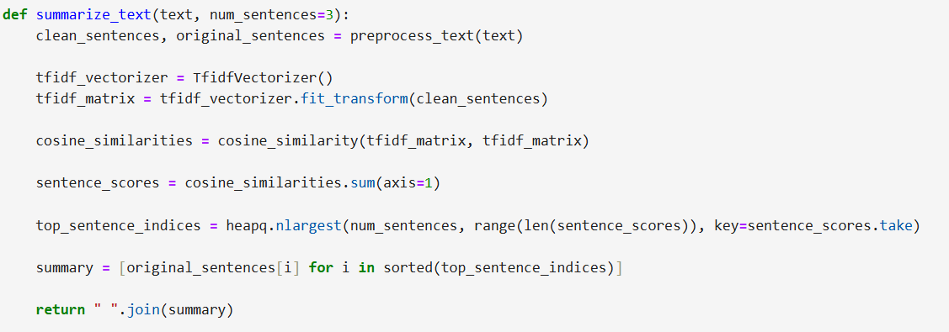
Code
Generates an extractive summary by cleaning text, calculating TF-IDF scores, and selecting top-ranked sentences based on cosine similarity.

Slide 14
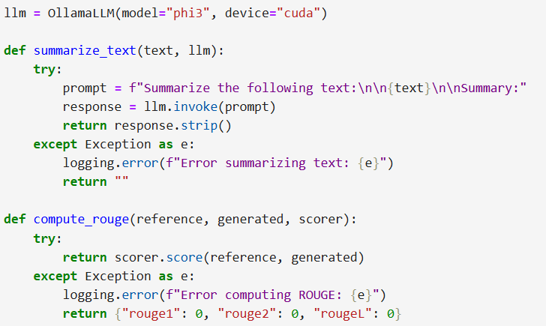
Code
Initializes the OllamaLLM model (phi3) for text summarization using CUDA.
The summarize_text function generates summaries by prompting the model and handles exceptions.
The compute_rouge function calculates ROUGE scores to evaluate the similarity between reference and generated summaries.

Slide 15
THANK YOU!

